Slide 1
Coursea Capstone What property to invest in London
Angela May 2019

Slide 2
Business Problem
Introduction:
The City of London, is most popular among tourist in the United Kingdom. It is diverse and is the financial capital of the UK. It is multicultural. It provides lot of business opportunities for providing accommodation for tourists. It has attracted many different players into the market, from big brand hotels to individuals.
This also means that the market is highly competitive. Thus having good location, price and reviews are crucial for individual to have frequent renters to their properties.
Problem Description:
Airbnb is among one of the most popular platform for home owners to rent out their property in London. For an individual to consider buying a property for rental on this platform, there are various factors need to be studied in order to decide on the Location such as :
Popularity in rental location
number of property in that neighbourhood
price of rental
popularity of property type etc

Slide 3
Data
Data 1 :
Airbnb summary information and metrics for listings in London is published and existed for free download on the
Data 2 :
GeoJSON file of neighbourhoods of London for properties in order to obtain exact location.
Data 3 :
The London Borough Profiles help paint a general picture of an area by presenting a range of headline indicator data in both spreadsheet and map form to help show statistics covering demographic, economic, social and environmental datasets for each borough, alongside relevant comparator areas. The London Borough Atlas does the same but provides further detailed breakdowns and time-series data for each borough.
Data 4:
Foursquare data will be called to add extra dimension to the analysis.
http://insideairbnb.com/get-the-data.html
http://insideairbnb.com/get-the-data.html
https://data.london.gov.uk/dataset/london-borough-profiles
http://www.foursquare.com/

Slide 4
Methodology
Gather Data from Airbnb open-soure data for London listings
Get latitude and longitude coordinates
Gather extra information from uk government website
Use Foursquare API to get venue data
Merge all dataset and visualise and summarise data, look for trends and highlights
Perform clustering on the data base on borough by using k-means clustering
Visualise and analyse data by cluster and provide recommendation

Slide 5
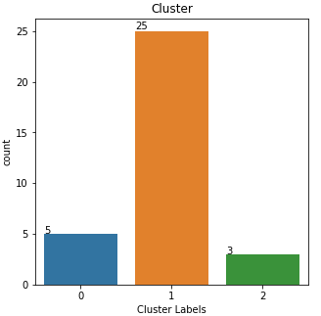
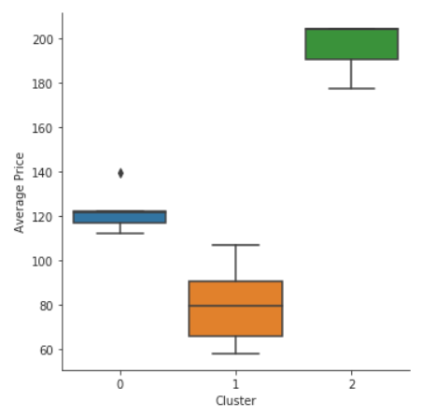
Results
Categorised the neighbourhoods into 3 cluster :
Cluster 0 : Neighbourhoods with new development area with moderate rental prices
Cluster 1 : Neighbourhoods with average rental price and wide spread of borough covering both inner and outer London. It is among the chest rental price among clusters.
Cluster 2 : Neighbourhoods that considered the most expensive areas, highest rental prices etc. With Westminster stands out to have the most entertainment as well as highest rental price.

Slide 6
Discussion and further analysis
What are the reason that Westminster is the stand-out area for restaurants and clubs ?
Are average house prices matches up with the level of rental price? If not, which area is the highest return for investment?
Cluster 1 covers most of the neighbourhoods, within the cluster, are there any borough that is deemed to be less attractive to investors?
Overall, most out standing neighbourhoods are within inner London, is there a borough in Outer London that looks more attractive for investors that would not want to purchase a property within inner London?

Slide 7
Conclusion
Answer to business question:
For investors seeking for new development area, Cluster 0 is recommended , especially Camden borough. It is most likely to get rental with a moderate rental price
For investors seeking for traditional expensive area, Cluster 2 is recommended , especially Westminster borough. It contains the most entertainment as well as on par with the highest rental price. It is also within close distance to tourist shopping and entertainment area.
Finding of this project will help relevant investor to capture on the opportunity on neighbourhood with higher possible income for Airbnb rental, hence consideration to purchase or list property on the platform

Slide 8
Thank you

